Slide 1

Sindh Maderssa_tul Islam University (SMIU)
Department of Software Engineering

Slide 2
PREPARED BY
AHMED SHAHI (BSE-23F-110)
MOIZ AHMED (BSE-23F-150)
ABDUL RAUF (BSE-23F-123)
SUBMITTED TO
MISS AQSA

Slide 3
VIRTUAL REALITY EDUCATION

Slide 4
Why Use VR in Education?
Personalized Learning
Safe Learning Environment:
Experiential Learning
VR can cater to different learning styles and speeds, offering customized learning experiences.
Provides a risk-
free space for
experimentation.
Students learn by doing, which enhances understanding and retention of complex concepts.

Slide 5
ENTITY-RELATIONSHIP MODEL.

Slide 6
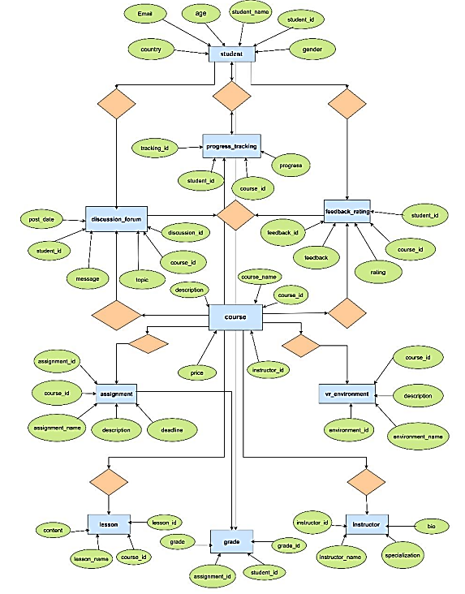

Slide 7
QUERIES

Slide 8
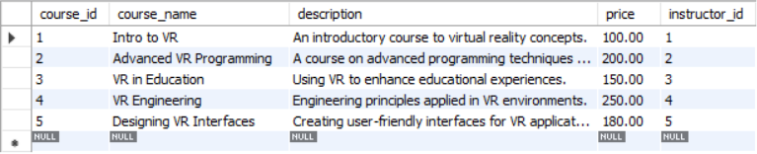

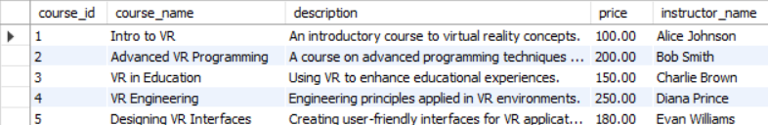
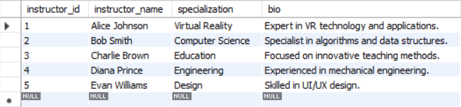
List of Courses with Instructor Details
Course Table
Query Output
Instructor Table

Slide 9
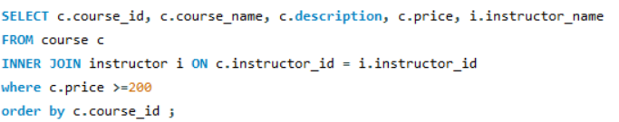
List of Courses According to price with Instructor Details
Course Table
Query Output
Instructor Table

Slide 10
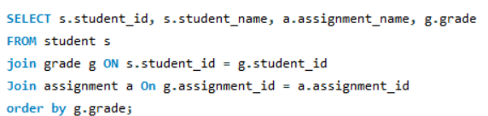
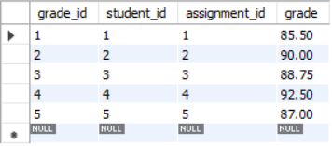
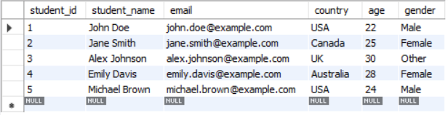
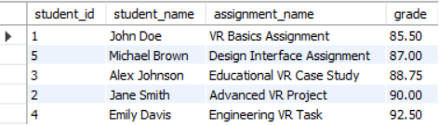
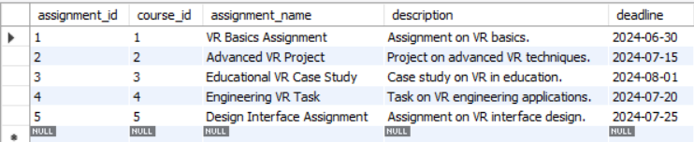
List of Student with Assignment & Grade Details
Grade Table
Student Table
Query Output
Assignment Table

Slide 11
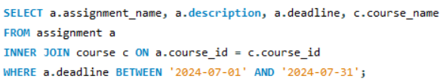

Assignments Due in July 2024 with Course Information
Course Table
Query Output
Assignment Table

Slide 12
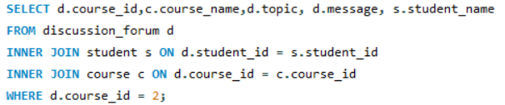
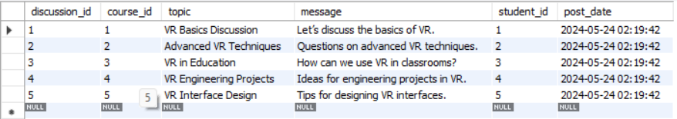
Discussion Topics and Messages for Course 2
Student Table
Query Output
Course Table
Discussion forum Table

Slide 13


Select students whose names start with 'J'
Student Table
Query Output

Slide 14


Find all female students
Student Table
Query Output

Slide 15
CONTRIBUTION
Ahmed Shahi
Moiz Ahmed
Abdul Rauf
Data Insert
10 Queries
Presentation
Project Idea
Table Create
Github Repository
15 Queries
ER-Model
19 Queries

Slide 16
THANK YOU

